Slide 1



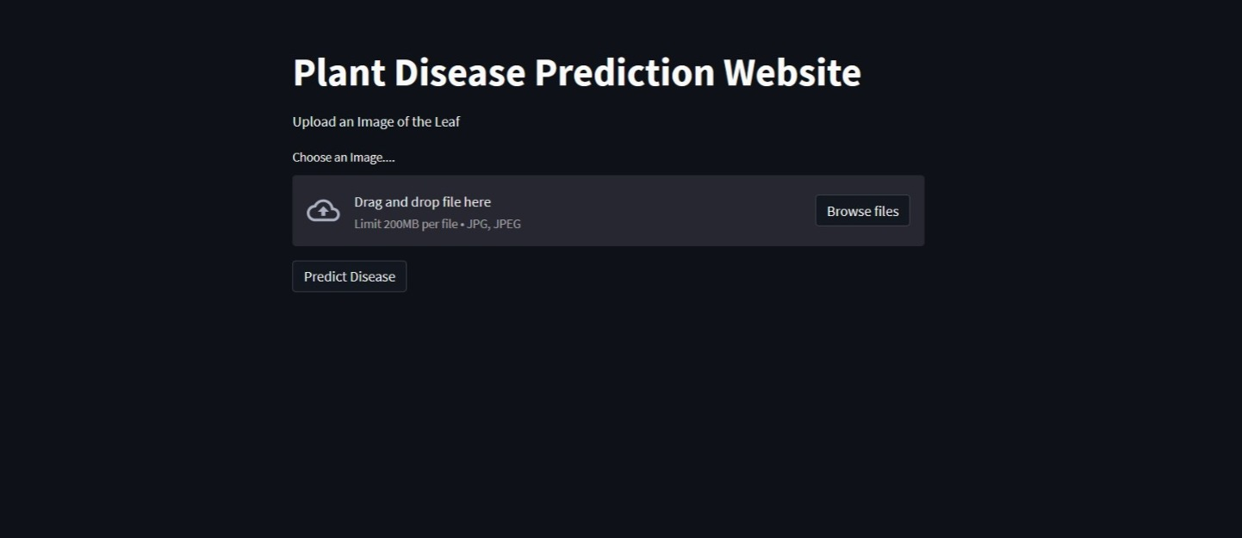
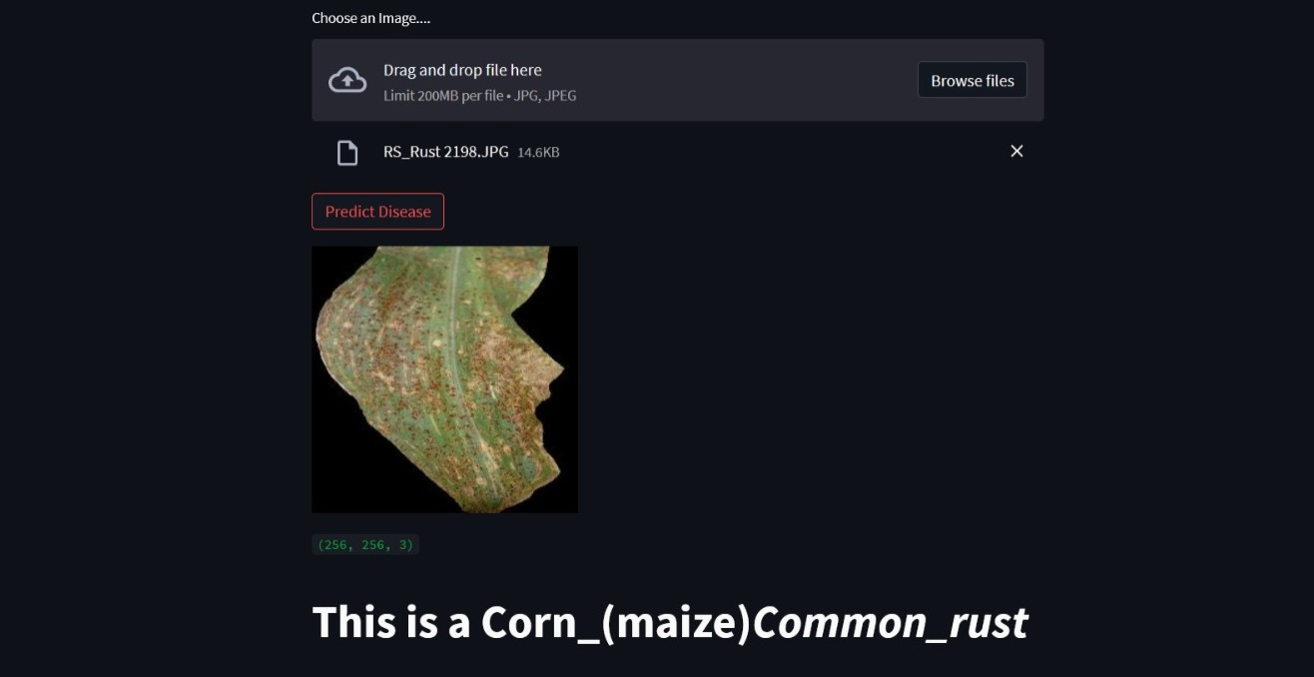
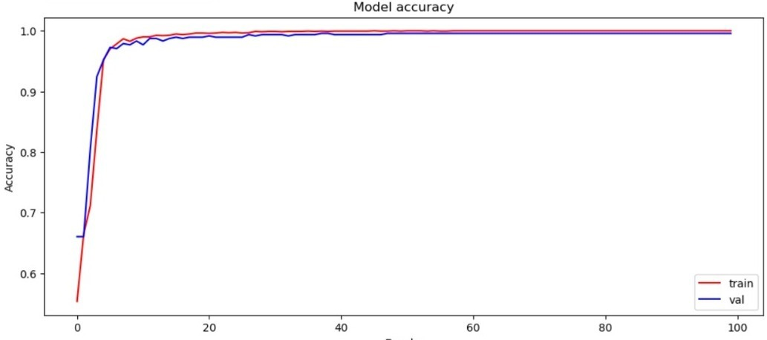
ENHANCED DETECTION ON LEAF DISEASES USING CNN
Department of Computer Science & Engineering
School of Computing
10214CS602– MINOR PROJECT-2
WINTER SEMESTER 2023-2024
ABSTRACT
INTRODUCTION
RESULTS
The enhanced detection of leaf diseases using Convolutional Neural Networks (CNN) yields promising results, showcasing the model's proficiency in accurately identifying and classifying various leaf diseases based on input images. The evaluation metrics, including accuracy, precision, recall, and F1 score, provide a comprehensive overview of the model's performance. High accuracy signifies the overall correctness of predictions, while precision emphasizes the accuracy of positive predictions. The recall metric measures the model's ability to capture all instances of a specific disease, indicating its effectiveness in disease identification.
In this project, we have developed an innovative plant disease detection system utilizing Convolutional Neural Networks (CNN) within a comprehensive machine learning framework. The system addresses the critical issue of plant diseases by automating the identification and classification process based on images of plant leaves. We have curated a diverse dataset encompassing various plant diseases, including Tomato Bacterial Spot, Potato Early Blight, and Corn (Maize) Common Rust Re-establishing a foundation for robust model training. The initial phase of the project involves exploratory data analysis, showcasing random samples from each disease category through a visual representation. The dataset is organized, incorporating labels and binary encoding for three dis-tinct plant diseases. The images are then split into training and testing sets, and further preprocessing involves normalizing pixel values and reshaping the data to fit the CNN architecture.
The project, titled ”Enhanced Detection On Leaf Diseases Using Convolutional Neural Networks (CNN),” represents a significant contribution to the field of precision agriculture by harnessing the power of machine learning for early diagnosis of plant diseases. Plant diseases pose a substantial threat to global food security, leading to significant crop losses if not detected and addressed promptly. In response to this challenge, our project focuses on developing an intelligent system that everages advanced image processing and machine learning techniques to identify and classify plant diseases accurately. The use of Convolutional Neural Networks (CNN) is a key highlight of this project, enabling the automated recognition of intricate patterns and features within images of plant leaves. We have curated a diverse dataset, encompassing common plant diseases such as Tomato Bacterial Spot, Potato Early Blight, and Corn (Maize) Common Rust. The project not only contributes to the advancement of machine learning applications in agriculture but also addresses the pressing need for efficient and accessible tools for farmers and agricultural practitioners.
Figure 1.Output
STANDARDS AND POLICIES
CONCLUSION
The enhanced detection system for leaf diseases using Convolutional Neural Net-works (CNNs) represents a promising and transformative approach in modern agriculture. The application of CNNs leverages the power of deep learning to accurately and efficiently identify various leaf diseases, contributing to the overall health and productivity of crops. The technical feasibility is underscored by the model’s ability to learn intricate patterns and features from diverse datasets, offering a robust solution for disease detection across different plant species and environmental condi-tions.
PyCharm:
PyCharm is a type of command line interface which explicitly deals with the ML(MachineLearning) modules And navigator is available in all the Windows, Linux and MacOS.The PyCharm has many number of IDE’s which make the coding easier. The UI can also be implemented in python.
Standard Used: ISO/IEC 27001
Jupyter:
It’s like an open source web application that allows us to share and create the documents which contains the live code, equations, visualizations and narrative text. It can be used for data cleaning and transformation, numerical simulation, statistical modeling, data visualization, machine learning.
TEAM MEMBER DETAILS
Student 1. 20076/Y.Saisri
Student 2 .19775/L.Nanda Kishore
Student 3 .19627/P.RajaSekhar
Student 1.9390398855
Student 2.9392562066
Student 3.9392315808
Student 1. vtu20076@veltech.edu.in
Student 2. vtu19775@veltech.edu.in
Student3. vtu19627@veltech.edu.in
ACKNOWLEDGEMENT
Chart 1. Training and Validation Accuracy.
ACKNOWLEDGEMENT
Dr.C.M Chidambaranathan,M.TECH,Ph.D.,/Assistant Professor
9940768671

